Slide 1
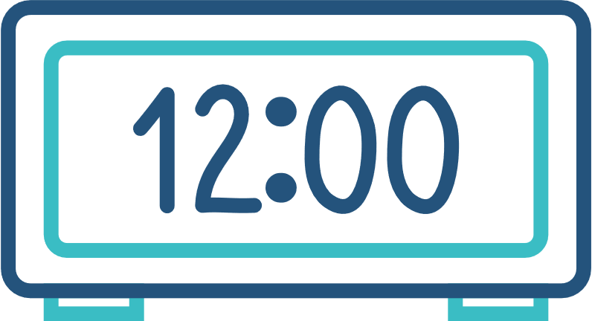
DIGITAL CLOCK
Presented By:
Vandan Kambodi (23IT042)
Lakshya Jivani (23IT039)
Prashant Gangani (23IT033)

Slide 2

OVERVIEW
A digital clock with day and date functions shows the current time, day of the week, and date, all in a clear numerical format. This feature helps users stay organized and aware of both time and calendar information at a glance.

Slide 3

TECHNOLOGY USED
GUI COMPONENTS
Java
Swing (for GUI)
AWT (for layout and components)
Time Label (timeLabel):
Displays the current time.
Font: Copperplate Gothic Bold, Size: 50, Color: White.
Day Label (dayLabel):
Shows the current day of the week.
Font: Copperplate Gothic Bold, Size: 25.
Date Label (dateLabel):
Displays the current date.
Font: Copperplate Gothic Bold, Size: 35.

Slide 4

CODE IMPLEMENTATION
Clock Class (Inherits JFrame)
Constructor (Clock())
Initializes the JFrame.
Sets up GUI components (labels for time, day, and date).
Configures layout and appearance.
setTime() Method
Continuously updates the time, day, and date every second.

Slide 5
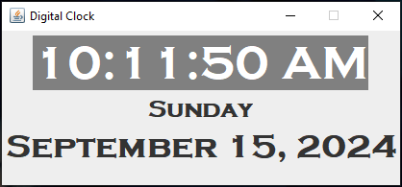
OUTPUT

Slide 6









Thank You!!

